Slide 1
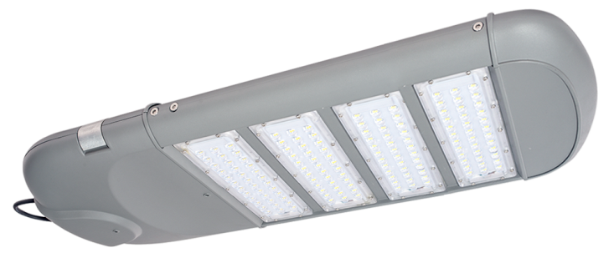
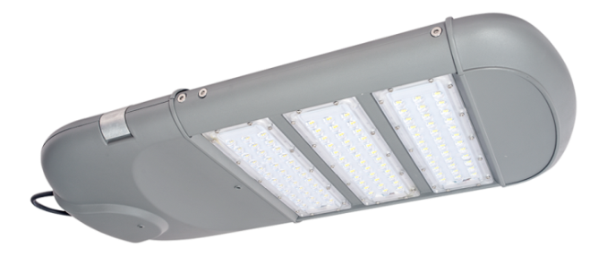
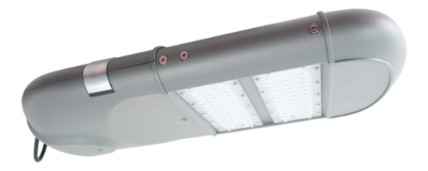
DC driver without strobe
The shell can dissipate the heat directly.
Built-in Driver
IP66
Street Light Series
ECO5032LD
ECO6032LD
ECO7032LD
Data Sheet www.sunecochina.com

Slide 2
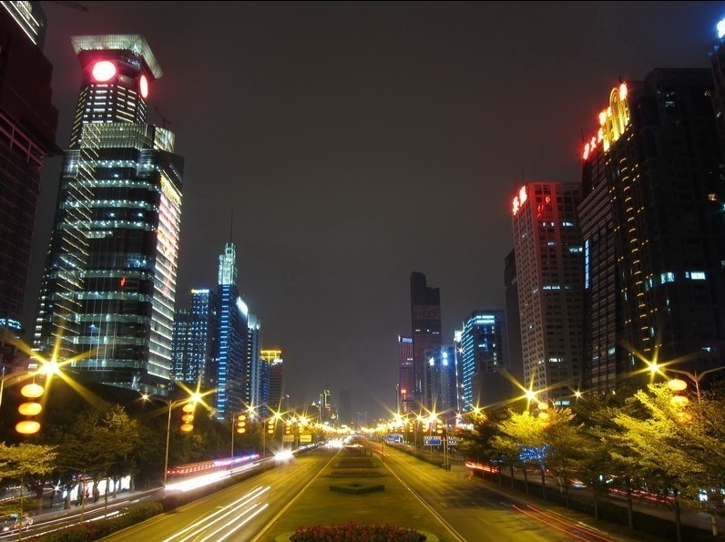
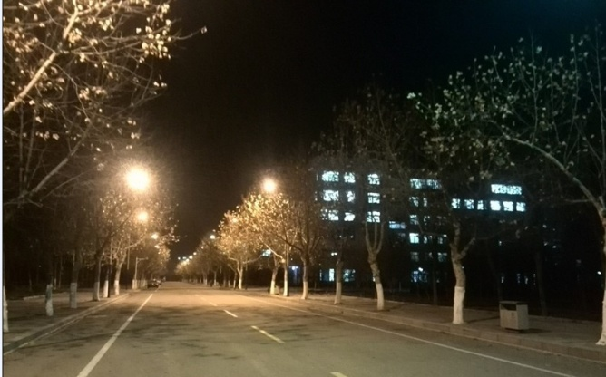
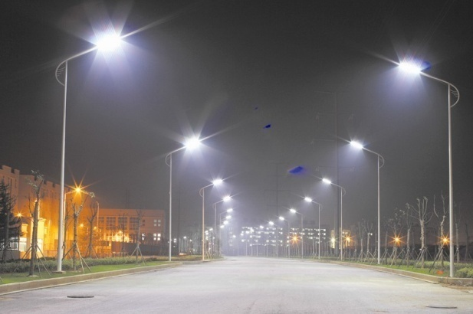
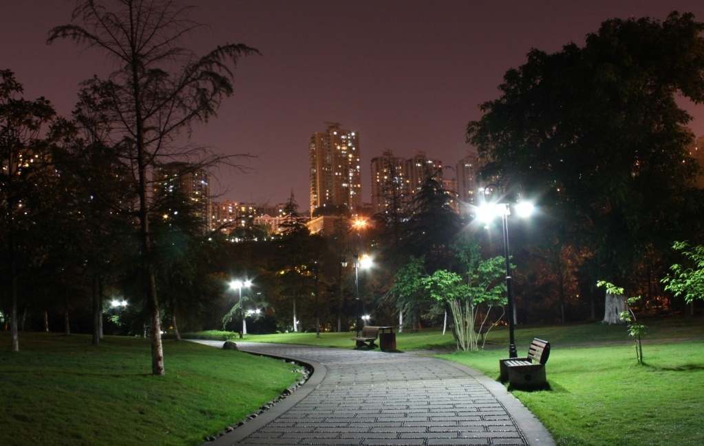
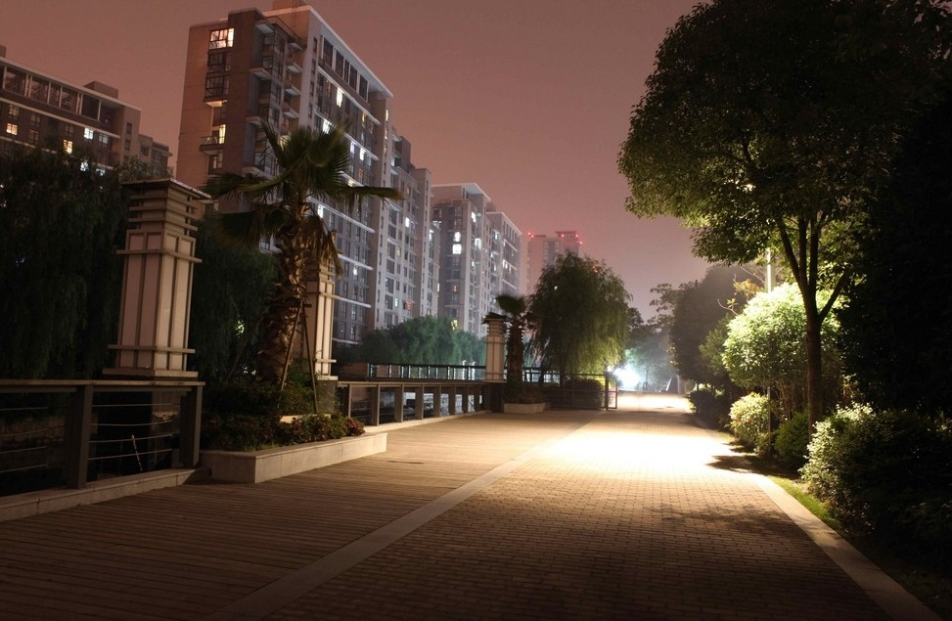
Application
City Road
School Road
Factory Street
Park Road
Residential road

Slide 3
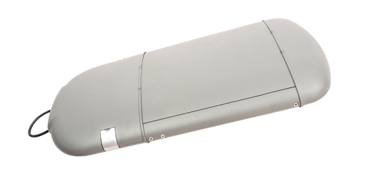
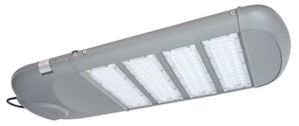
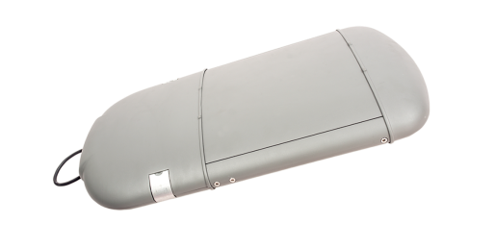
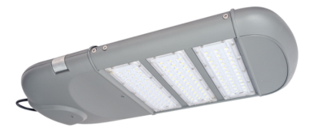
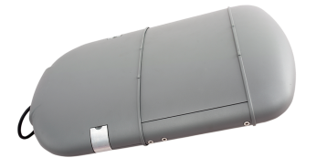
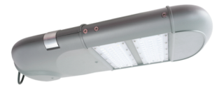
Product Description
Light Source: high light efficiency, low light depreciation, light source module
Shell: The lamp shell can dissipate the heat directly, which improve the heat-sinking function and increase the lamp power. The lamp fixture, without heat-sinking tooth at the back, has good self-cleaning properties, not easy for dirt retention.
Effect: Use PC lens, soft light and uniform illumination.
Driver: Built-in
Firmness: The lamp fixture itself use PC lens, not traditional glass, and aluminum, which is firm enough and convenient for transportation.
IP Rating: IP65.
Application: city road, sidewalks, square, school, park, yard, residential areas, factory and other outdoor lighting areas.
ECO7032LD
ECO6032LD
ECO5032LD

Slide 4
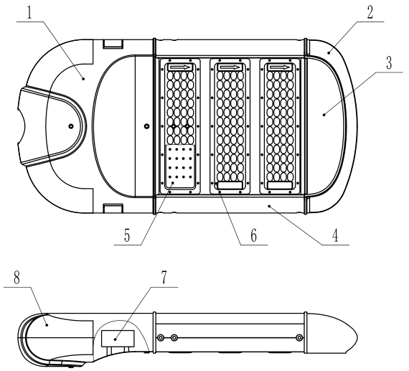
Structural Chart
This lamp is composed of the bottom case of electrical box, front cover, small cover, heat-sink, light source module, lens, power, and upper cover of the electrical box. The structural chart is as follows:
ECO7032LD
No. | Name | No. | Name
1 | Bottom Cover of Electrical Box | 5 | Light Source module
2 | Front Cover | 6 | Lens
3 | Small cover | 7 | Power Supply
4 | Heat Sink | 8 | Upper Cover of Electrical Box
ECO6032LD
ECO5032LD

Slide 5
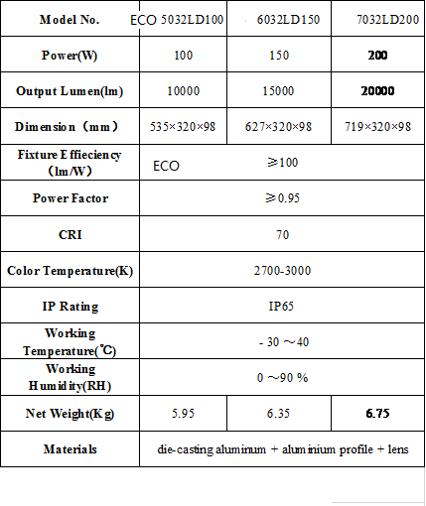
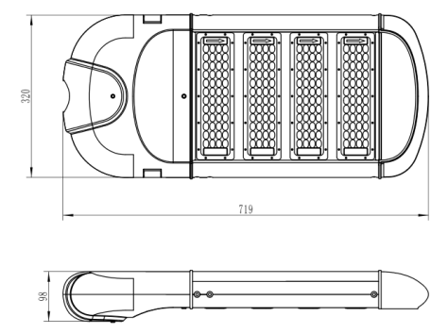
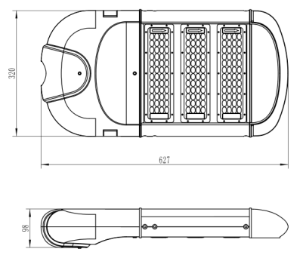
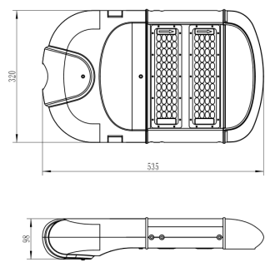
Parameter
ECO7032LD
ECO6032LD
ECO5032LD

Slide 6
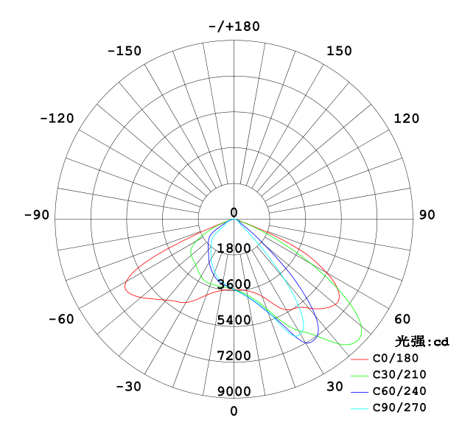
Light Distribution
ECO6032LD Light Distribution

Slide 7
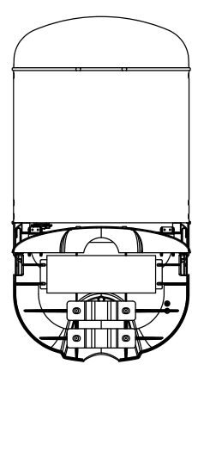
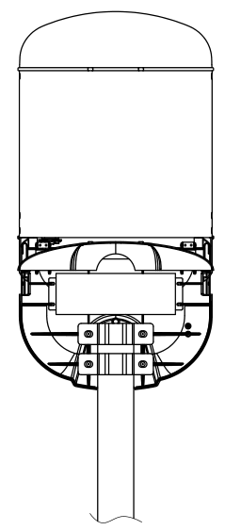
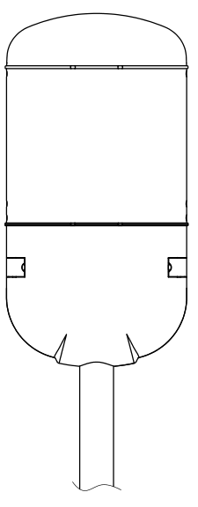
Installation
1
When you install the light, the first step is to fix the lamp on the street lamp pole through the lamp installation bracket. Connect the null wire, the earth wire, the live wire of the cable wire with the power system according to the requirements (there is connection mark). After checking, connect the electricity, then the street lamp can work normally. The specific installation steps are as follows:
2
1. Open the back cover, fix the lamp through pressing plate of the pole, and fix the lamp in the pole.
2. Connect the wires according to the connecting mark:
3. Close the back cover, fix it with the clip. Please note not to press the cable.
Connecting Mark： N L
N：Null Wire ：Ground Wire L：Fire Wire
3

